Slide 1
Capstone Engagement
Assessment, Analysis, and Hardening of a Vulnerable System

Slide 2
Table of Contents
This document contains the following sections:
01
Network Topology
02
Red Team: Security Assessment
03
Blue Team: Log Analysis and Attack Characterization
Hardening: Proposed Alarms and Mitigation Strategies
04

Slide 3
Network Topology
‹#›

Slide 4
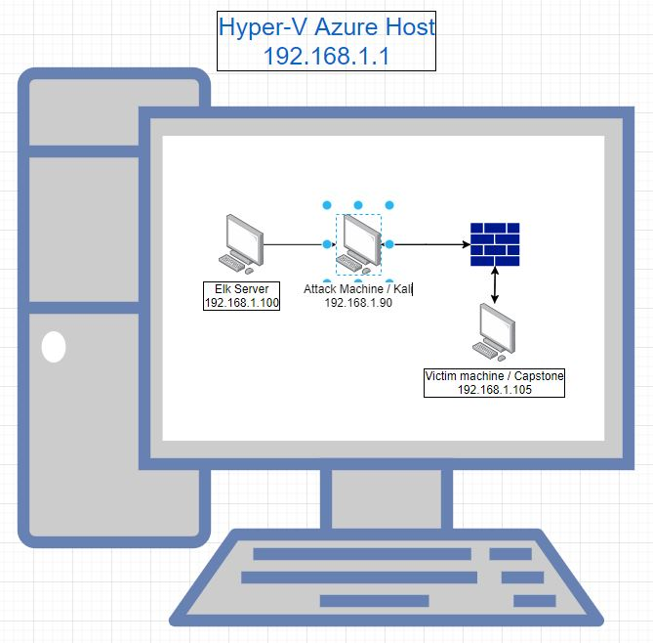
Network Topology
Network
Address Range:
192.168.1.0/24
Netmask: 255.255.255.0
Gateway: 192.168.1.1
Machines
IPv4: 192.168.1.90
OS: Kali linux 2020.1
Hostname: Attack machine / Kali
IPv4: 192.168.1.105
OS: Apache/2.4.29 Ubuntu/ 18.04.1
Hostname: Victim Machine / Capstone
IPv4: 192.168.1.100
OS: Ubuntu 18.04.4
Hostname: ELK Server
IPv4:192.168.1.1
OS: Windows 10 Pro
Hostname: MINGW64

Slide 5

Red Team
Security Assessment
‹#›

Slide 6
Recon: Describing the Target
Nmap identified the following hosts on the network:
Hostname | IP Address | Role on Network
Windows 10 Pro | 192.168.1.1 | Host Machine, used to view all other VMs as well as running Kibana on the ELK
ELK Server | 192.168.1.100 | Monitors the Capstone maching using Kibana
Victim Machine / Capstone | 192.168.1.105 | Victim machine, targeted by the KALI machine
Attack machine / Kali | 192.168.1.90 | Attacker Machine

Slide 7
Vulnerability Assessment
The assessment uncovered the following critical vulnerabilities in the target:
Vulnerability | Description | Impact
SSH port 80 open | Nmap reveals that port 80 is open as well as the network range and the open IP | An attacker can access the server via HTTP//: in the browser
Sensitive/unprotected information 1 | References to a “/Secret_Folder” location in the “/company_folders” directly | An attacker would see the hidden folder as an access point
No mitigation on Brute force attacks | There was no mitigation on brute force cracking for passwords of the users of the server | An attacker can use brute force attacks on a users password
Sensitive/unprotected information 2 | Users are listed under their first name which can be accessed via reconnisinse through the “meet_our_team/” folder | An attacker can use the information gathered to launch an attack

Slide 8
Vulnerability Assessment
The assessment uncovered the following critical vulnerabilities in the target:
Vulnerability | Description | Impact
Compromised information 1 | Accessing the “/company_folders/Secret_Folder” reveals the hidden “/connect_to_corp_server” file | Using the cracked password and username an attacker can reveal the file contents.
Compromised information 2 | Revealed in the “/company_folders/Secret_Folder/connect_to_corp_server” file was a hash for the Administrator user Ryan, a Md5 hash for said admin as well as instructions on how to upload files to the server | An attacker can use the hash and username to gain further access into the server
Unauthorized file upload | No mitigation of files uploaded through the Webdav function | An attacker can use this function to upload malicious scripts
Bonus: SSH port 80 open (again) | Can access the server with Admin login and password | An attacker can bypass uploading a reverse TCP script by accessing the server directly via SSH

Slide 9
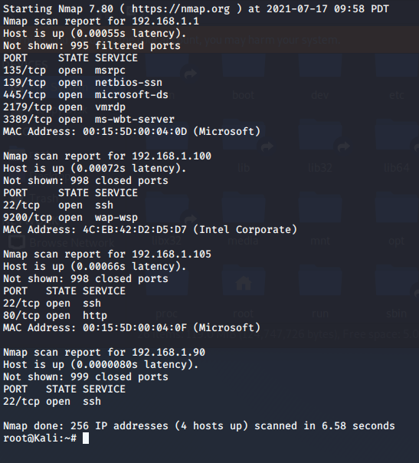
Exploitation:SSH port 80 open
01
02
03
Tools & Processes
Using Nmap revealed the network map and shows the open port 80 in the ip 192.168.1.105. Using a browser i accessed the server via HTTP//:192.168.1.105
Achievements
I am able to access the server directory, revealing that there is no Index.php. I browse around and gain reconnaissance about users and stumbble upon references to a “Secret_folder”
[INSERT: screenshot or command output illustrating the exploit.]

Slide 10
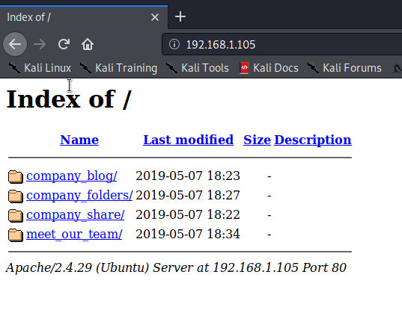
Exploitation:SSH port 80 open

Slide 11
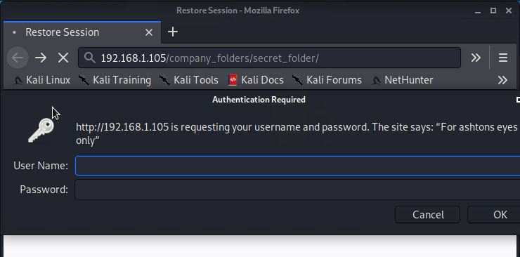
Exploitation: Sensitive/unprotected information 1 & 2
01
02
03
Tools & Processes
Manually entering the address http://192.168.1.105/company_folders/secret_folder prompted for a password entry
Achievements
From here i was able to inquire that the password needed was Ashton’s password and
that Ashton
was a user
that i could
target
Screenshot:

Slide 12
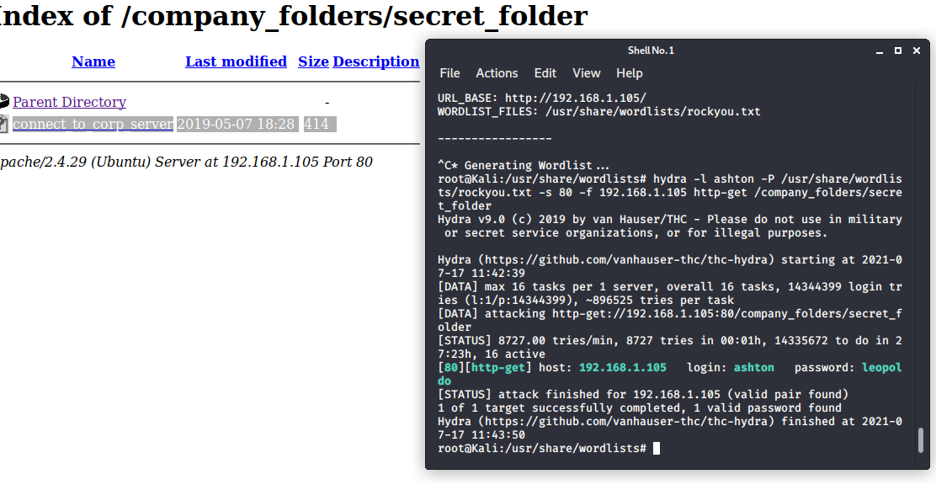
Exploitation:No mitigation on Brute force attacks
01
02
03
Tools & Processes
I decided to try and crack the password with a basic cracking program through my kali machine via port 80
Achievements
Using Hydra to crack the password for Ashton I was able to access the Secret_folder
directory

Slide 13
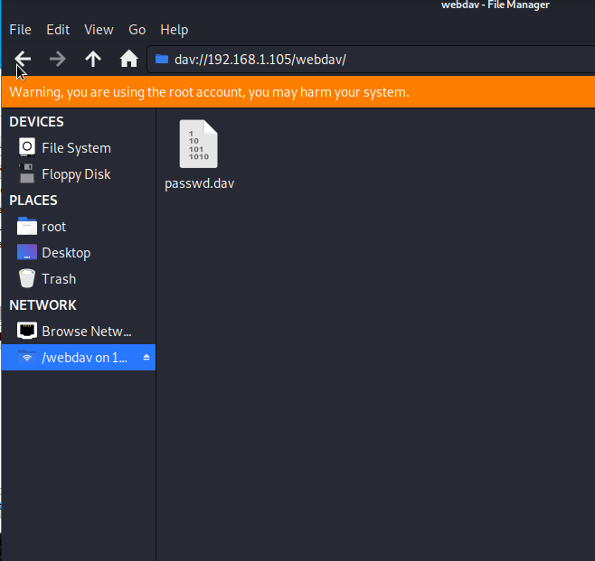
Exploitation: Compromised information 1 & 2
01
02
Open Webdav session
Tools & Processes
Accessing the files through the hidden server directory “/company_folders/Secret_Folder” i found a file titled “connect_to_corp_server” which revealed several pieces of sensitive information, The username and hashed password for an administrator account as well as detailed instructions on how to upload files to the server.
Achievements
After breaking the simple MD5 hash that was Ryan’s password I was able to use this information to open a Webdav session for the victims server.

Slide 14
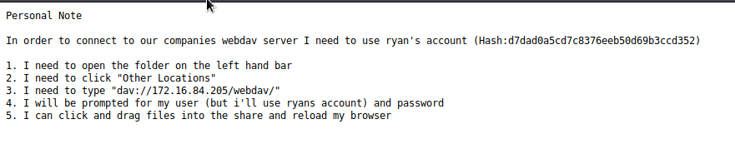
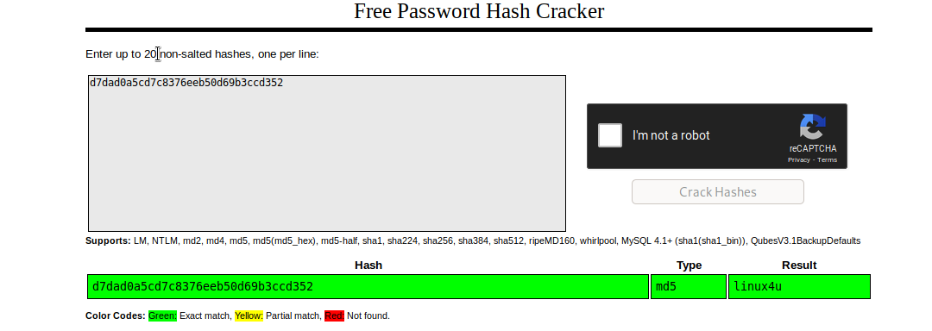
Exploitation: Compromised information 1 & 2
“/company_folders/Secret_Folder/connect_to_corp_server”
Ryan’s Hash

Slide 15
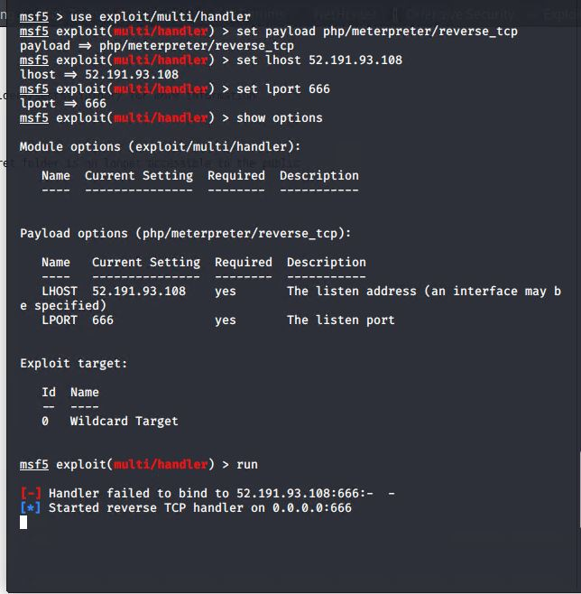
Exploitation: Unauthorized file upload
01
02
Tools & Processes
Using the msf5 console and msfvenom I was able to generate a malicious reverse TCP script and subsequently upload it to the server.
Achievements
Upon successful upload i was able to create a reverse tcp connection and gain root access to the server via ryan’s account

Slide 16
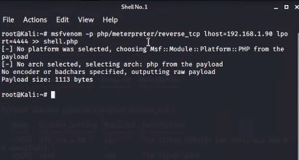
Exploitation: Unauthorized file upload
Generated malicious script

Slide 17
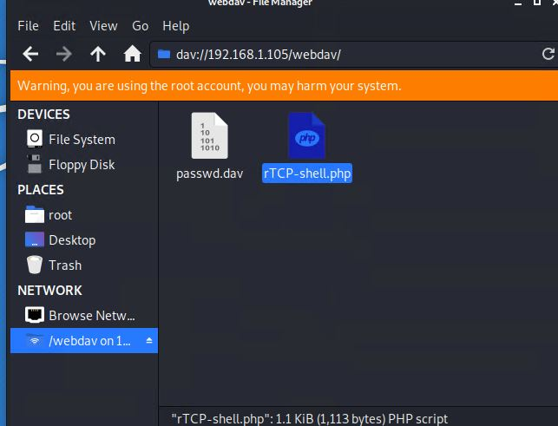
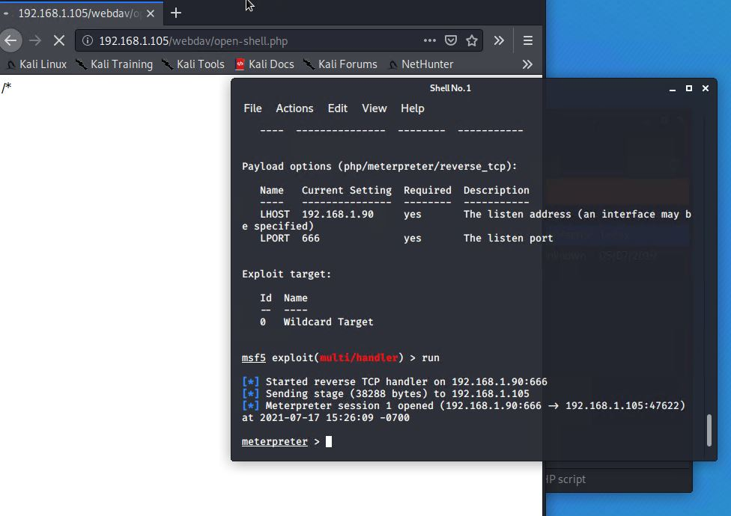
Exploitation: Unauthorized file upload
Webdav File Upload

Slide 18

Blue Team
Log Analysis and Attack Characterization
‹#›

Slide 19

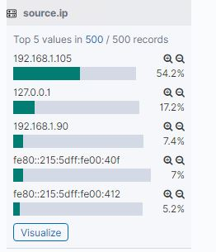
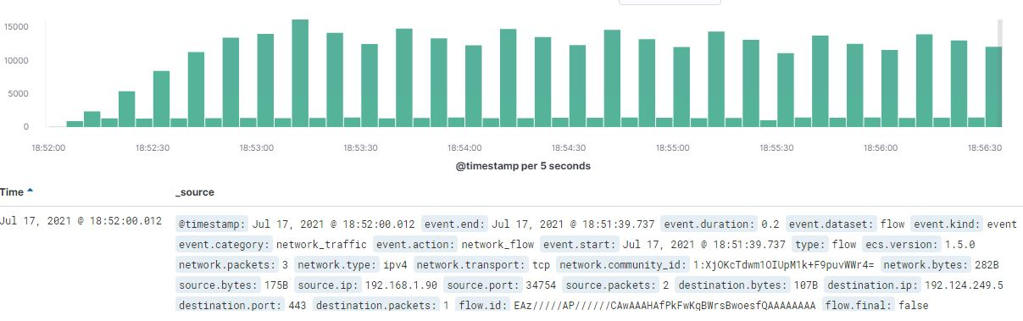
Analysis: Identifying the Port Scan
What time did the port scan occur? The port scan started on Jul 17, 2021 @ 18:52:00.012
How many packets were sent, and from which IP? 3 packets were initially sent from the source IP 192.168.1.90
There are a few indications that this is the port scan
The first indication was that there were an excessive amount of hits in a short amount of time.
We can see here that the most amount of hits to the site aside from an internal network and the host network was our attacker IP address
Looking at a short section of the hits from that source ip shows a consistent amount of hits in short time

Slide 20
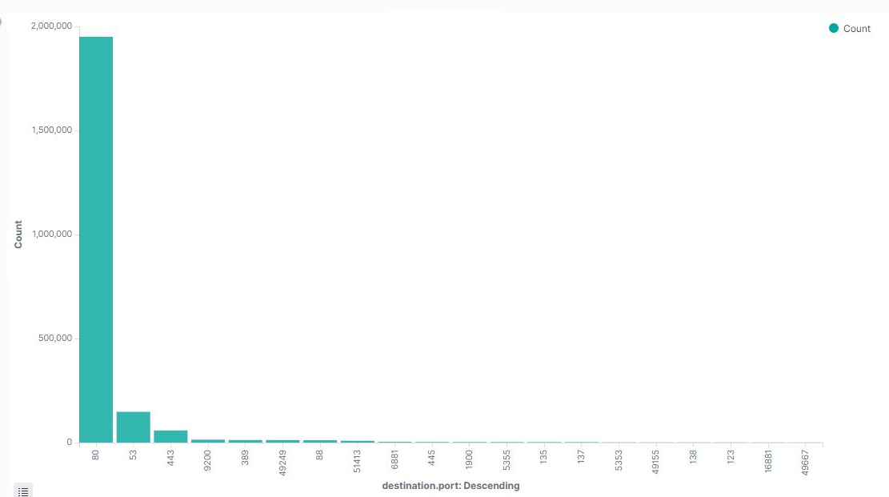
Analysis: Identifying the Port Scan
There are a few indications that this is the port scan
Looking further into the hits shows that a large number of ports were targeted

Slide 21
Analysis: Finding the Request for the Hidden Directory
What time did the request occur?Jul 17, 2021 @ 18:35:56.000
How many requests were made? 32,627

Slide 22
Analysis: Uncovering the Brute Force Attack
Answer the following questions in bullet points under the screenshot if space allows. Otherwise, add the answers to speaker notes.
How many requests were made in the attack?
How many requests had been made before the attacker discovered the password?
[Insert Here]
Include a screenshot of Kibana logs depicting the brute force attack.

Slide 23
Analysis: Finding the WebDAV Connection
Answer the following questions in bullet points under the screenshot if space allows. Otherwise, add the answers to speaker notes.
How many requests were made to this directory?
Which files were requested?
[Insert Here]
Add a screenshot of Kibana logs depicting the WebDAV connection.

Slide 24
Blue Team
Proposed Alarms and Mitigation Strategies
‹#›

Slide 25
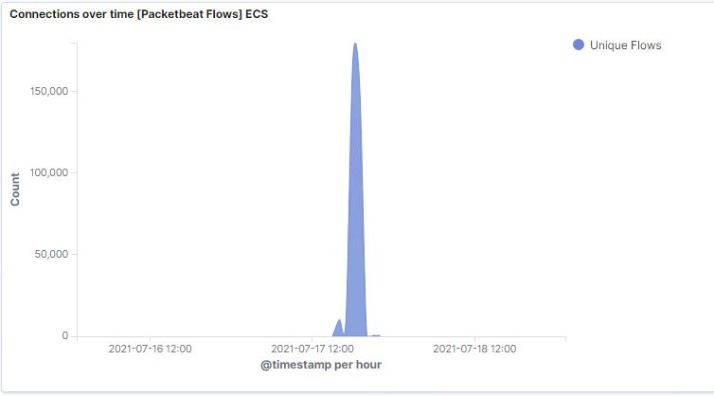
Mitigation: Blocking the Port Scan
Most of the connections per hour were less than 1000 aside from the Nmap port scan. Set an alarm to trigger after 1000 connections per hour
Configuration and patching the firewall on a regular basis to ensure as few as possible zero-day attacks as well as ensuring that the firewall stops unwanted traffic properly
Extra mitigation on port 80 and other know ports
Run a port scan regularly to determine if any ports are open or have been opened

Slide 26
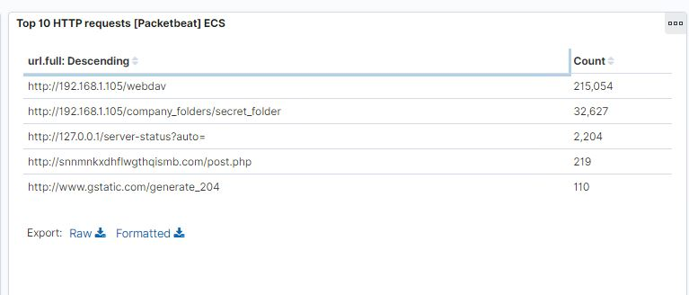
Mitigation: Finding the Request for the Hidden Directory
I would set an alarm every time there are more than 20,000 requests made
Setting further restrictions on hidden folders.
Removing references in error messages
Two factor identification for access to hidden folders

Slide 27
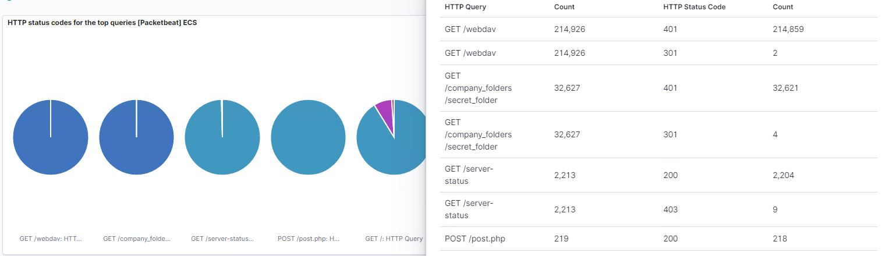
Mitigation: Preventing Brute Force Attacks
Any time a 401 error count exceeds 50,000 requests in an hour
What threshold would you set to activate this alarm?
Better password policy namely limiting the password attempts before an account, I would say 5 attempts
Describe the solution. If possible, provide the required command line(s).

Slide 28
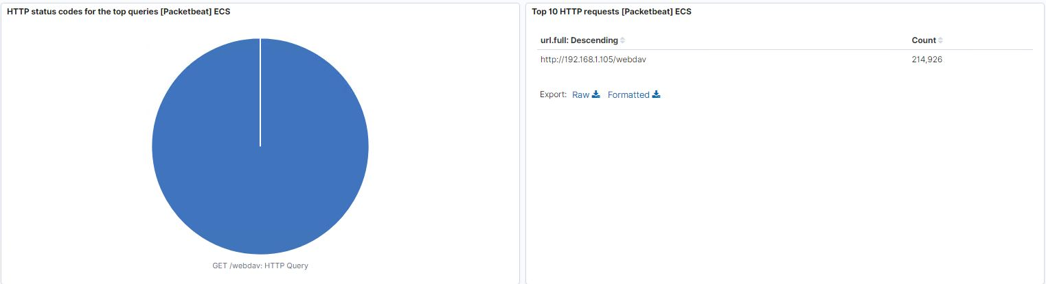
Mitigation: Detecting the WebDAV Connection
Whitelist the IP of only necessary users, any other ip trying to access would trigger an alarm
What threshold would you set to activate this alarm?
Policy around employees sharing their passwords/access/leaving files with instruction on admin logins
Describe the solution. If possible, provide the required command line(s).

Slide 29
Mitigation: Identifying Reverse Shell Uploads
What kind of alarm can be set to detect future file uploads?
What threshold would you set to activate this alarm?
What configuration can be set on the host to block file uploads?
Describe the solution. If possible, provide the required command line.

